Slide 1

Dynamo:
Amazon’s Highly-Available
Key-Value Store
Giuseppe DeCandia, Deniz Hastorun, Madan Jampani, Gunavardhan
Kakulapati, Avinash Lakshman, Alex Pilchin, Swaminathan
Sivasubramanian, Peter Vosshall and Werner Vogels
Amazon.com
Notes:
SIGOPS07 HoF Award
SOSP17

Slide 2
Outline
Background
System Requirements
Design Principles
System Architecture
Evaluation
Conclusion

Slide 3
Outline
Background
System Requirements
Design Principles
System Architecture
Evaluation
Conclusion

Slide 4

Background
"Our goal was to build a database that would have the unbounded SCALABILITY, CONSISTENT performance and the high AVAILABILITY to support the needs of our rapidly growing business."
"What started out as an exercise in solving our own needs in a CUSTOMER obsessed way…”
Werner Vogels
CTO - Amazon,com
Background
Notes:
Unavailability == $$$

Slide 5
Outline
Background
System Requirements
Design Principles
System Architecture
Evaluation
Conclusion

Slide 6
System Requirements
Property | Rationale
Query Model | No operations span multiple data items and there is no need for relational schema.
ACID | Dynamo targets applications that operate with weaker consistency (the ”C” in “ACID”) if this results in high availability.
Efficiency | At Amazon, SLAs are expressed and measured at the 99.9th percentile of the distribution.
Other | For internal use and no security related requirements.
System Requirements

Slide 7
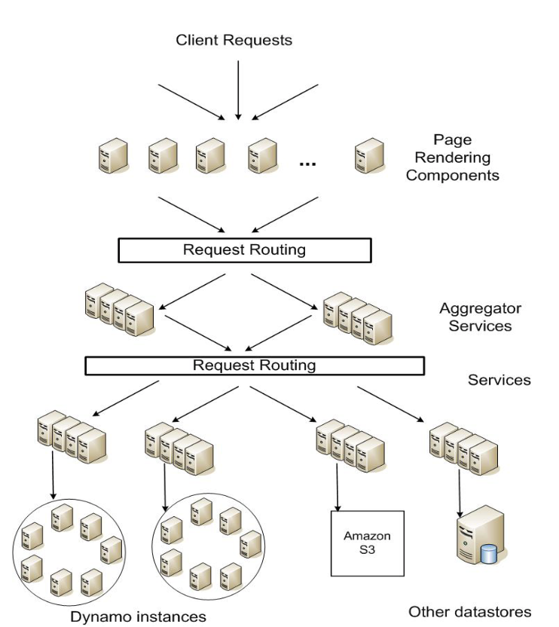
Service Level Agreements (SLA)

Slide 8
Outline
Background
System Requirements
Design Principles
System Architecture
Evaluation
Conclusion

Slide 9
Distributed Storage
Optimistic replication allows changes to propagate asynchronously. Availability is increased, but the risk is that you have multiple, conflicting versions of data in the system.
Conflicts aren’t prevented, but resolved.
Notion of an “eventually consistency data store” and delay reconciliation.
When to solve: resolving conflicts during reads, not writes (always writable)
Who to solve: tradeoff between system and application level resolution.
Design Principles

Slide 10
Key Design Principles
Principle | Rationale
Incremental Scalability | Dynamo should be able to scale out one storage host at a time.
Symmetry | Every node in Dynamo should have the same set of responsibilities as its peers; there should be no distinguished node or nodes that take special roles or extra set of responsibilities.
Decentralization | An extension of symmetry, the design should favor decentralized peer-to-peer techniques.
Heterogeneity | The system needs to be able to exploit heterogeneity.
Design Principles

Slide 11
Outline
Background
System Requirements
Design Principles
System Architecture
Implementation & Lessons
Conclusion

Slide 12
Dynamo Techniques
Problem | Technique
Partitioning and replication | Consistent Hashing (notions of “eventually consistent” and delayed reconciliation).
Recovering from failures | Hinted Handoff and Merkle trees used to quickly detect inconsistencies.
Consistency | Quorum-like techniques and object versioning.
Membership | Gossip-based membership protocol, also used for failure detection.
Decentralized | Minimal need for manual administration.
System Architecture

Slide 13
Easy usage: Interface
get(key)
return single object or list of objects with conflicting version and context
put(key, context, object)
store object and context under key
Context encodes system meta-data, e.g. version number
System Architecture
Notes:
The context is opaque to caller.

Slide 14
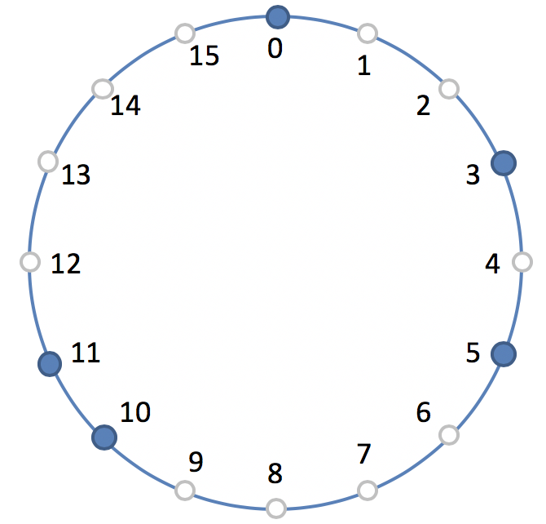
Partitioning
Scale incrementally by dynamically partition the data over the set of nodes (i.e., storage hosts) in the system.
Consistent Hashing: the output range of the hash function returns is a bounded, circular region.
Newly added nodes are randomly assigned a key/position.
Nodes are responsible for the values ranging from the previous node to themselves.
System Architecture

Slide 15
Partitioning: Add a Node
Data: (A, X]
X
A
B
Data: (A, B]
Data: (X, B]
G
C
Data: (B, C]
F
E
D
Data: (C, D]
System Architecture

Slide 16
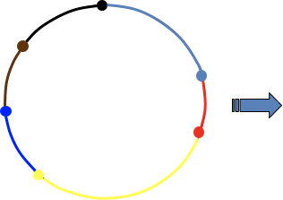
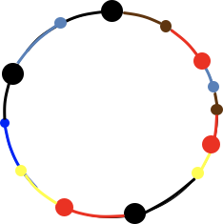
Partitioning: Virtual Nodes
Consistent hashing may lead to imbalance:
Node identifiers may not be balanced
Data identifiers may not be balanced
Heterogeneous nodes
System Architecture
Notes:
There are two strategies that a client can use to select a node: (1) route its request through a generic load balancer that will select a node based on load information, or (2) use a partition-aware client library that routes requests directly to the appropriate coordinator nodes.
The advantage of the first approach is that the client does not have to link any code specific to Dynamo in its application, whereas the second strategy can achieve lower latency because it skips a potential forwarding step.
In general, only k/N keys need to be remapped when k is the number of keys and N is the number of servers (more specifically, the maximum of the initial and final number of servers).
Dynamo can be characterized as a zero-hop DHT, where each node maintains enough routing information locally to route a request to the appropriate node directly.

Slide 17
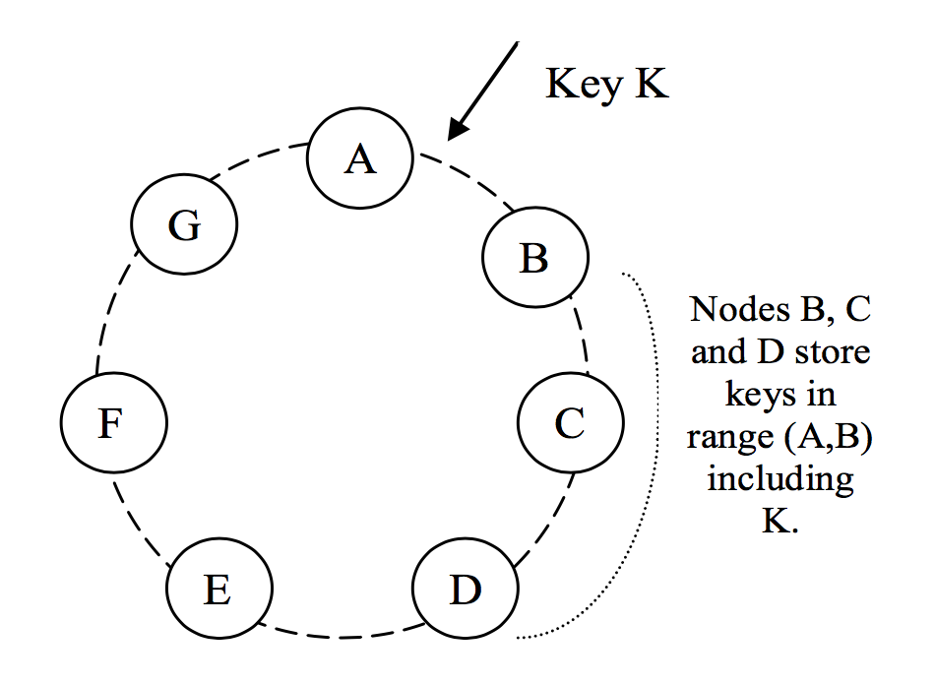
Replication
To achieve high availability, Dynamo replicates data across nodes.
Each key is assigned a “coordinator” node that is responsible for handling replication.
The coordinator, in turn, handles replication for all items that fall within its range.
The coordinator replicates these keys at the N-1 clockwise successor nodes in the ring.
This list of key-owners is called the preference list.
System Architecture

Slide 18
Replication: Add a Node
Node A
Node G
Data: (A, X]
X
Node X
Node A
Node A
Node G
A
B
Data: (X, B]
Data: (A, B]
G
Node B
Node X
Node A
C
Data: (B, C]
F
E
D
Node C
Node B
Data: (C, D]
System Architecture

Slide 19
Handling Failures: Hinted Handoff
1
When A is temporarily down or unreachable during a write, send replica to D
D is hinted that the replica belongs to A and it will deliver to A when A is recovered.
1
1’
A
B
1
C
1’
D
1’
System Architecture

Slide 20
Handling Failures: Hinted Handoff
1’
When A is temporarily down or unreachable during a write, send replica to D
D is hinted that the replica belongs to A and it will deliver to A when A is recovered.
1
1’
A
B
1
C
1’
D
System Architecture

Slide 21

Handling Failures: Hinted Handoff
When A is temporarily down or unreachable during a write, send replica to D
D is hinted that the replica belongs to A and it will deliver to A when A is recovered.
Tolerate failure of a data center
- Each object replicated across multiple data centers
System Architecture

Slide 22
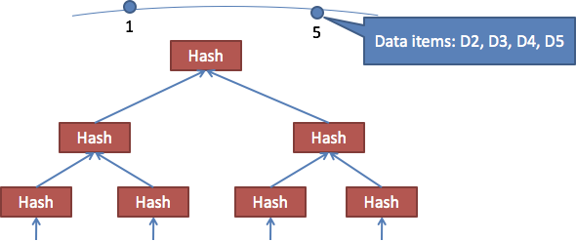
Handling Failures: Replica Sync
Anti-entropy for replica synchronization
Use Merkle trees for fast inconsistency detection and minimum transfer of data
System Architecture

Slide 23
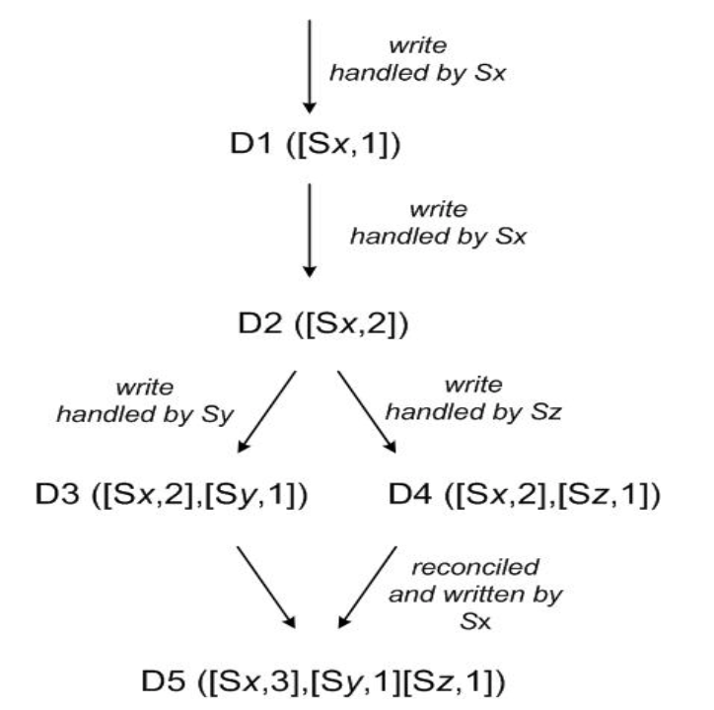
Consistency: Vector Clocks
Dynamo guarantees “eventual consistency”. Updates are propagated asynchronously.
A vector clock is effectively a list of (node, counter) pairs.
Use vector clocks for capturing causality
If causal, older version can be forgotten
If concurrent, conflict exists requiring reconciliation
System Architecture

Slide 24
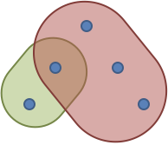
Consistency: Sloppy Quorum
R /W: the minimum number of nodes that must participate in a read/write request
R + W > N (quorum)
If it receives multiple versions, it will reconcile and write-back a new version
Create a new version
(R:4, W:2, N:5)
System Architecture
Notes:
W = 1, high availability, low durability

Slide 25
Consistency: Sloppy Quorum
Example:
put(): The coordinator node will:
Create a new version
Send the data to N healthy nodes
If W - 1 response, treat the write as successful
get(): The coordinator node will:
Request versions of that data from N highest-ranked reachable nodes in the preference list.
Waits for R responses before returning the result to the client. If it receives multiple versions, it will reconcile and write-back a new version(superseding the previous one).
System Architecture
Notes:
R=1, High performance read engine

Slide 26
Membership & Failure Detection
System Architecture
Notes:
Gossip based

Slide 27
Outline
Background
System Requirements
Design Principles
System Architecture
Evaluation
Conclusion

Slide 28
Storage Node Overview
Built in JAVA
Each storage node has three main components.
Request Coordination
Membership and failure detection
Local Persistence Engine: Pluggable
Implementation & Lessons

Slide 29
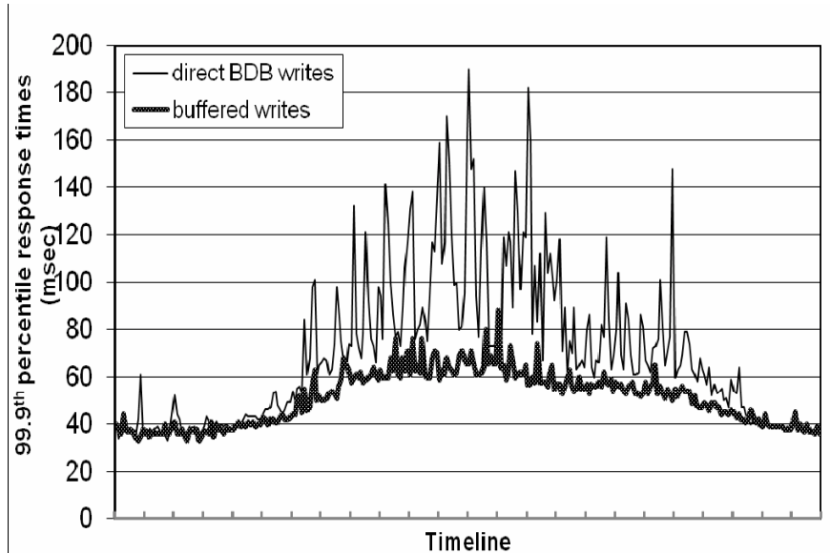
Performance Tradeoffs
Implementation & Lessons

Slide 30
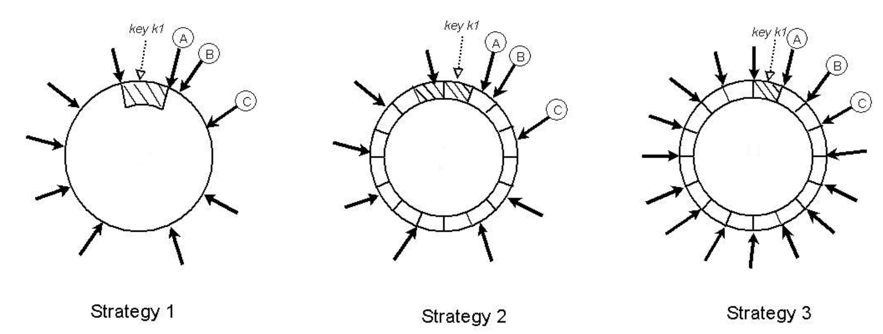
Load Distribution Strategies
Implementation & Lessons

Slide 31
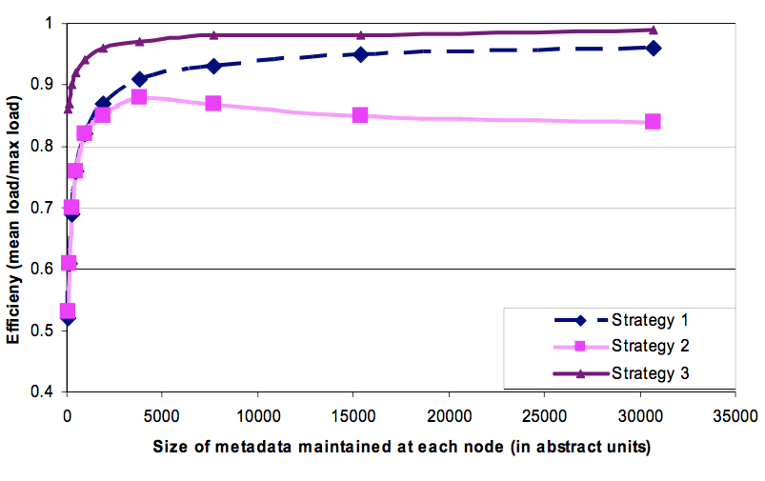
Load Balancing Efficiency
Implementation & Lessons

Slide 32
Coordination
There are two ways of locating a node to service a request:
A load-balancer can determine the node for a given key request. The burden is on the load-balancer system.
The client can periodically sample a random node (every 10 seconds), grab its membership state and use that to query nodes directly.
 | 99.9th percentile read latency (ms) | 99.9th percentile write latency (ms) | Average read latency (ms) | Average write latency (ms)
Server-driven | 68.9 | 68.5 | 3.9 | 4.02
Client-driven | 30.4 | 30.4 | 1.55 | 1.9
Implementation & Lessons

Slide 33
Divergent Versions
Divergent versions of a data item occur when
Failures are happening, such node or data center failures.
A large number of writes against the same data are happening, and multiple nodes are handling the updates.
 | 1 version | 2 versions | 3 versions | 4 versions
Portion(%) | 99.94 | 0.00057 | 0.00047 | 0.00009
Implementation & Lessons

Slide 34
Usage Patterns
Dynamo is used by several services with different configurations to achieve their desired levels of performance, availability and durability.
Common: (N: 3, R: 2, W: 2)
High-performance read: (N: 3, R: 1, W: 3)
High-performance write: (N: 3, R: 3, W: 1) - dangerous
Implementation & Lessons

Slide 35
Outline
Background
System Requirements
Design Principles
System Architecture
Evaluation
Conclusion

Slide 36
Conclusion
Dynamo is a highly available and scalable data store, that provides customers with the ability to customize their storage system to meet their desired performance, durability and consistency SLAs.
Conclusion

Slide 37

Q & A

Slide 38
Reference
Amazon
Werner Vogels, Blog Post, 02 Oct 2007.
https://www.allthingsdistributed.com/2007/10/amazons_dynamo.html
Press
A Conversation with Werner Vogels: https://queue.acm.org/detail.cfm?id=1142065
A Guide to Consistent Hashing: https://www.toptal.com/big-data/consistent-hashing
https://www.cnblogs.com/liangmou/p/7786345.html
https://zhuanlan.zhihu.com/p/27853552
https://chenjiayang.me/2018/08/05/paper-Dynamo/
https://cs.uwaterloo.ca/~tozsu/courses/CS848/W15/presentations/JeffAvery-Dynamo.pdf
10 years on, Amazon CTO reflects on DynamoDB launch: https://www.theregister.co.uk/2017/10/06/10_years_on_amazons_cloud_chief_reflects_on_dynamodb_launch/
Reference

